Slide 1
CREATING THE NEW NORMAL
July 1, 2020

Slide 2
TODAY’S OBJECTIVES
Go over survey results
Who we are
What you like and don’t like about Encorepreneur
What you think of Zoom meetings
What
Discuss some possible new directions
Request your continued help as we look at creating a new normal.
Notes:
If this is your first encorepreneur meeting, I apologize….. Usually this is where I introduce the speaker… but this time you are stuck with me…

Slide 3
THE SURVEY
Survey sent to everyone on mailing list
3,700 individuals
About 3,000 have been to at least one meeting
320 total responses
94%) have attended a meeting
(15%) have attended more than 25 meetings
(37%) have been to more than 10 meetings
(23%) are Supporting Encorepreneurs
Notes:
We sent this to our mailing list of 3,700 people and got a 9% response rate – which I think is pretty good. Notice that 94% of the people who responded have been to at least one meeting…..that means that ½ of 1% of people who have not attended

Slide 4
GENDER
We still have more men than women attendees, but we made a little progress.

Slide 5
We tend to feel younger than we are – and the gap is widening.
AGE
We are a pretty “experienced” group – 59 years old
Notes:
note age is pretty steady – down from 60 to 59 in last 5 years

Slide 6
ARE WE WORKING
About 32% are 65 and over, but only 13% are fully retired and

Slide 7
EMPLOYMENT LEVEL
58% are C-Level executives or above and another 18% are senior management.

Slide 8
ENTREPRENEURSHIP
Almost 50% of our respondents were founders of their businesses or organizations.

Slide 9
RETIREMENT AGE
We are leaving the work force later than many. 63% are retiring after age 65.

Slide 10
LIFE AFTER RETIREMENT
75% plan to work part or full-time after retirement.

Slide 11
WHERE WE LIVE AND WORK
Neighborhood | Work | Home
Short Pump/Goochland | 21% | 22%
Near West End | 14% | 14%
Bon Air/Boulders | 13% | 12%
Scott’s Addition | 11% | 0%
Midlothian | 9% | 20%
Downtown | 8% | 0%
West End | 8% | 14%
Museum District/VCU | 7% | 9%
Northside | 6% | 7%
Mechanicsville | 3% | 0%
We live and work all over, but mostly north of the river and in the suburbs.

Slide 12
OUR BUCKET LISTS

Slide 13
BREAKFASTS ARE WELL LIKED
You rated breakfasts as 8.93 using the Net Promoter Score question.
Suggestions to improve included…
More networking
More diversity
More politics/less politics
Better food and beverage

Slide 14
BREAKFASTS – WHAT WE LIKE
We like breakfasts for multiple reasons.

Slide 15
SPEAKERS & TOPICS – WHAT WE LIKE
We like to hear from inspirational and successful people, and we like to learn.

Slide 16
SURVEY EXTRAS - SPEAKERS & LOCATIONS
There are more than 12 good speakers and locations!
More than 300 suggestions
Most are viable
Some are over my pay grade
Good news
Many duplicates but probably 50-75 different viable ideas
Bad news
We could never get to all them
That means we have more then 5 years “backlog”

Slide 17
Breakfast Speakers and Venues
If you have any suggestions for speakers or venues for future ZOOM or in-person events, please send them to “everyone” using the Chat feature. .

Slide 18
SURVEY EXTRAS - VOLUNTEERS!
Volunteering was clearly a leading interest of respondents
Mentioned everywhere it was appropriate
Several variations
A monthly or annual volunteer day for encorepreneurs
A special project addressed as a group
Making connections between non-profits and encorepreneurs
“Adopting” one or more non-profits
Having more non-profits as speakers

Slide 19
ZOOM MEETINGS
96% have attended other ZOOM meetings
Most are familiar with the technology
Some love ZOOM and some have “had enough”
Most thought it at least good enough for now.

Slide 20
ZOOM MEETINGS – HOW TO IMPROVE
Virtual tours of new venues
Use breakout rooms to allow networking
Use polling, etc. to be more interactive
Attract speakers from outside Richmond
My favorite was “Have a singalong”

Slide 21
SURVEY TAKE-AWAYS
Very loyal community of individuals
Active, experienced managers and entrepreneurs
Very interested in networking
Wide variety of interests centered around
Being “in the game”
Learning and doing
Giving back
Room for more than 12 speakers a year
Technology-accepting if not embracing
They want to travel and experience new things

Slide 22
5 PROPOSED NEW DIRECTIONS FOR ENCOREPRENEUR
An Encorepreneur Community that supports…..
Encorepreneur Groups (Councils)… that implement
Encorepreneur Adventures
Encorepreneur Menterns
“Everyday Heroes” Award Program
Other volunteer efforts

Slide 23
ENCOREPRENEUR “VIRTUAL COMMUNITY”
“Virtual Community” is a technology platform that facilitates communication and interaction (networking) among “communities” of people.
Encorepreneur! is already a community in its simplest form
Events
Emails
Website
A more robust platform would allow many new capabilities

Slide 24
ENCOREPRENEUR “VIRTUAL COMMUNITY”
A “Virtual Community” would:
Leverage the content, database, brand and technology of Encorepreneur!
Increase communication among encorepreneurs though capabilities such as:
A searchable directory of members and potential members
Digital bulletin boards for jobs, mentorships, referrals, etc.
A platform to post news, blogs and other communications
Support the formation of smaller communities or “Groups” within Encorepreneur

Slide 25
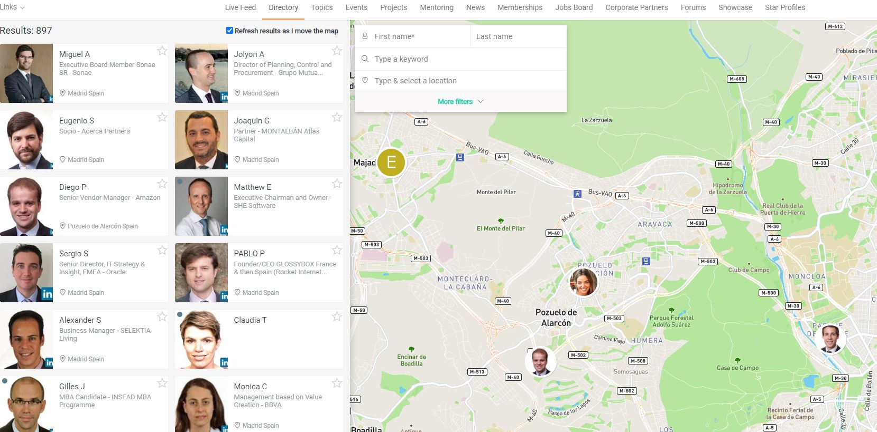
ENCOREPRENEUR COMMUNITY
STARTS WITH A GREAT LIST OF MEMBERS

Slide 26
ENCOREPRENEUR GROUPS – Mini-Encorepreneur!’s
Groups or “subsets” of 25-100 encorepreneurs who
Share an interest in a particular topic
Are set-up and managed by one or more members
Meet regularly on ZOOM or in person for speakers
A way for encorepreneurs to:
focus on their individual interests
network with people with similar interests
create their own “mini-encorepreneurs”
“Mini Encorepreneur!”
Examples might include:
Start-up businesses
Industries like health care, or cyber-security
Public affairs
Hobbies
Book clubs

Slide 27
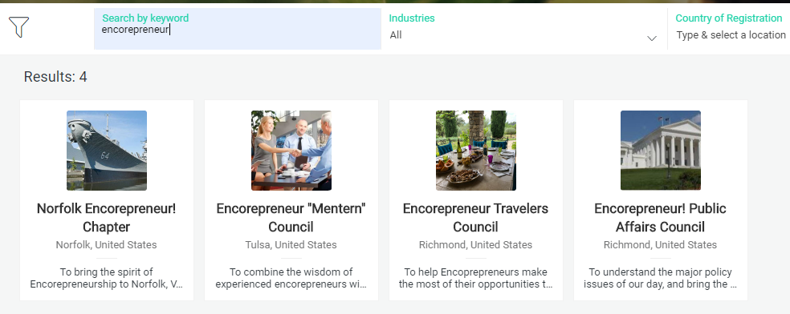
ENCOREPRENEUR GROUPS

Slide 28
GROUPS
If you would be interested in forming, managing or participating in a group focused on something that interests you, please send them to “everyone” using the Chat feature.

Slide 29
ENCOREPRENEUR! ADVENTURES
If you have an idea for an interesting “Encorepreneur! Adventure” please send it “everyone” using the Chat feature.

Slide 30
THE “MENTERNS” GROUP
Menterns (a combination of mentor and intern)
People with experience who provide “wisdom” to younger colleagues
In return, they share the perspective & expertise of their young mentees.
This program would link the two groups
Survey results
Significant interest in being a mentor
A modest number of respondents had opportunities for having a mentor.
Not as much enthusiasm for the concept as for others

Slide 31
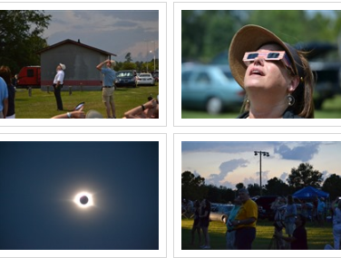
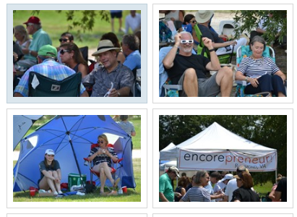
THE ENCOREPRENEUR! ADVENTURES GROUP

Slide 32
ENCOREPRENEUR! ADVENTURES
Group travel and trips to unique locales or events
The northern (or southern) lights
photo safaris
a rocket launch
tours of unique places.
Survey results
Moderate interest compared to other programs
High level of people interested in participating
“Bucket List” response indicates interest in travel might be high

Slide 33
WHAT’S NEXT?
We have learned a lot
About encorepreneurs
About what encorepreneurs are interested in
About speakers and venues
About ZOOM
About a technology framework
But there are many more questions
What people and financial resources are needed?
Are those resources available?
What does the future hold given Covid-19
Are you interested in helping?
Got to think about it
May be calling some of you to see if you want to help
Call me or send an email
Zoom meeting

Slide 34
Q And A

Slide 35
THANK YOU!

